Slide 1
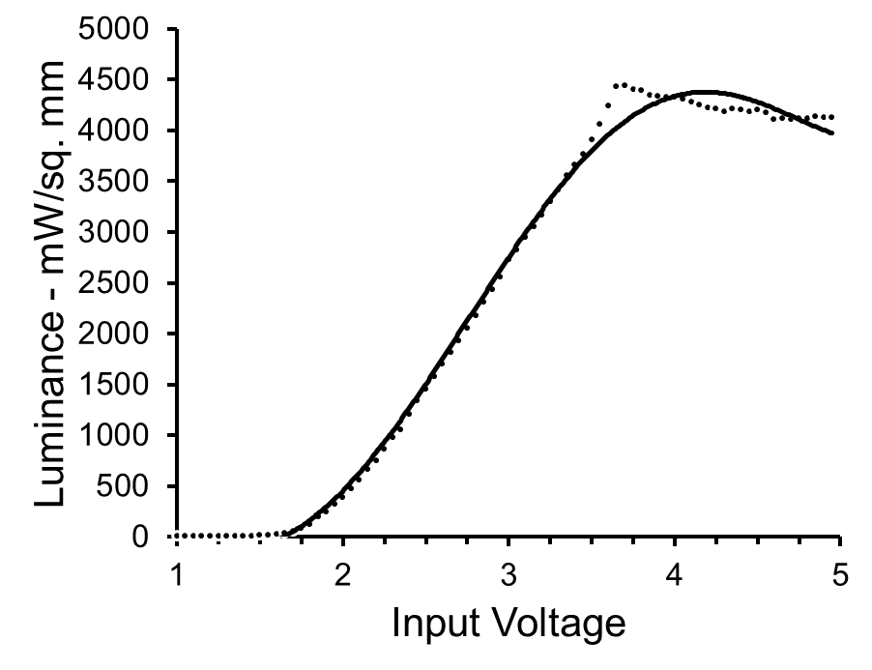
Optical output of the Laser LED device. Short (1 ms) light pulses were generated using the digital-to-analog output of a laboratory computer as input to the device and output using a 0.200 mm diameter optical fiber (ThorLabs #M83L01). Light intensity was measured using a Laser Power and Energy Meter (ThorLabs #PM100USB), with the ferule attached to the end of the optical fiber in direct contact with the sensor. Optial power was measured using a custom Labview application and converted to luminance.

